Slide 1
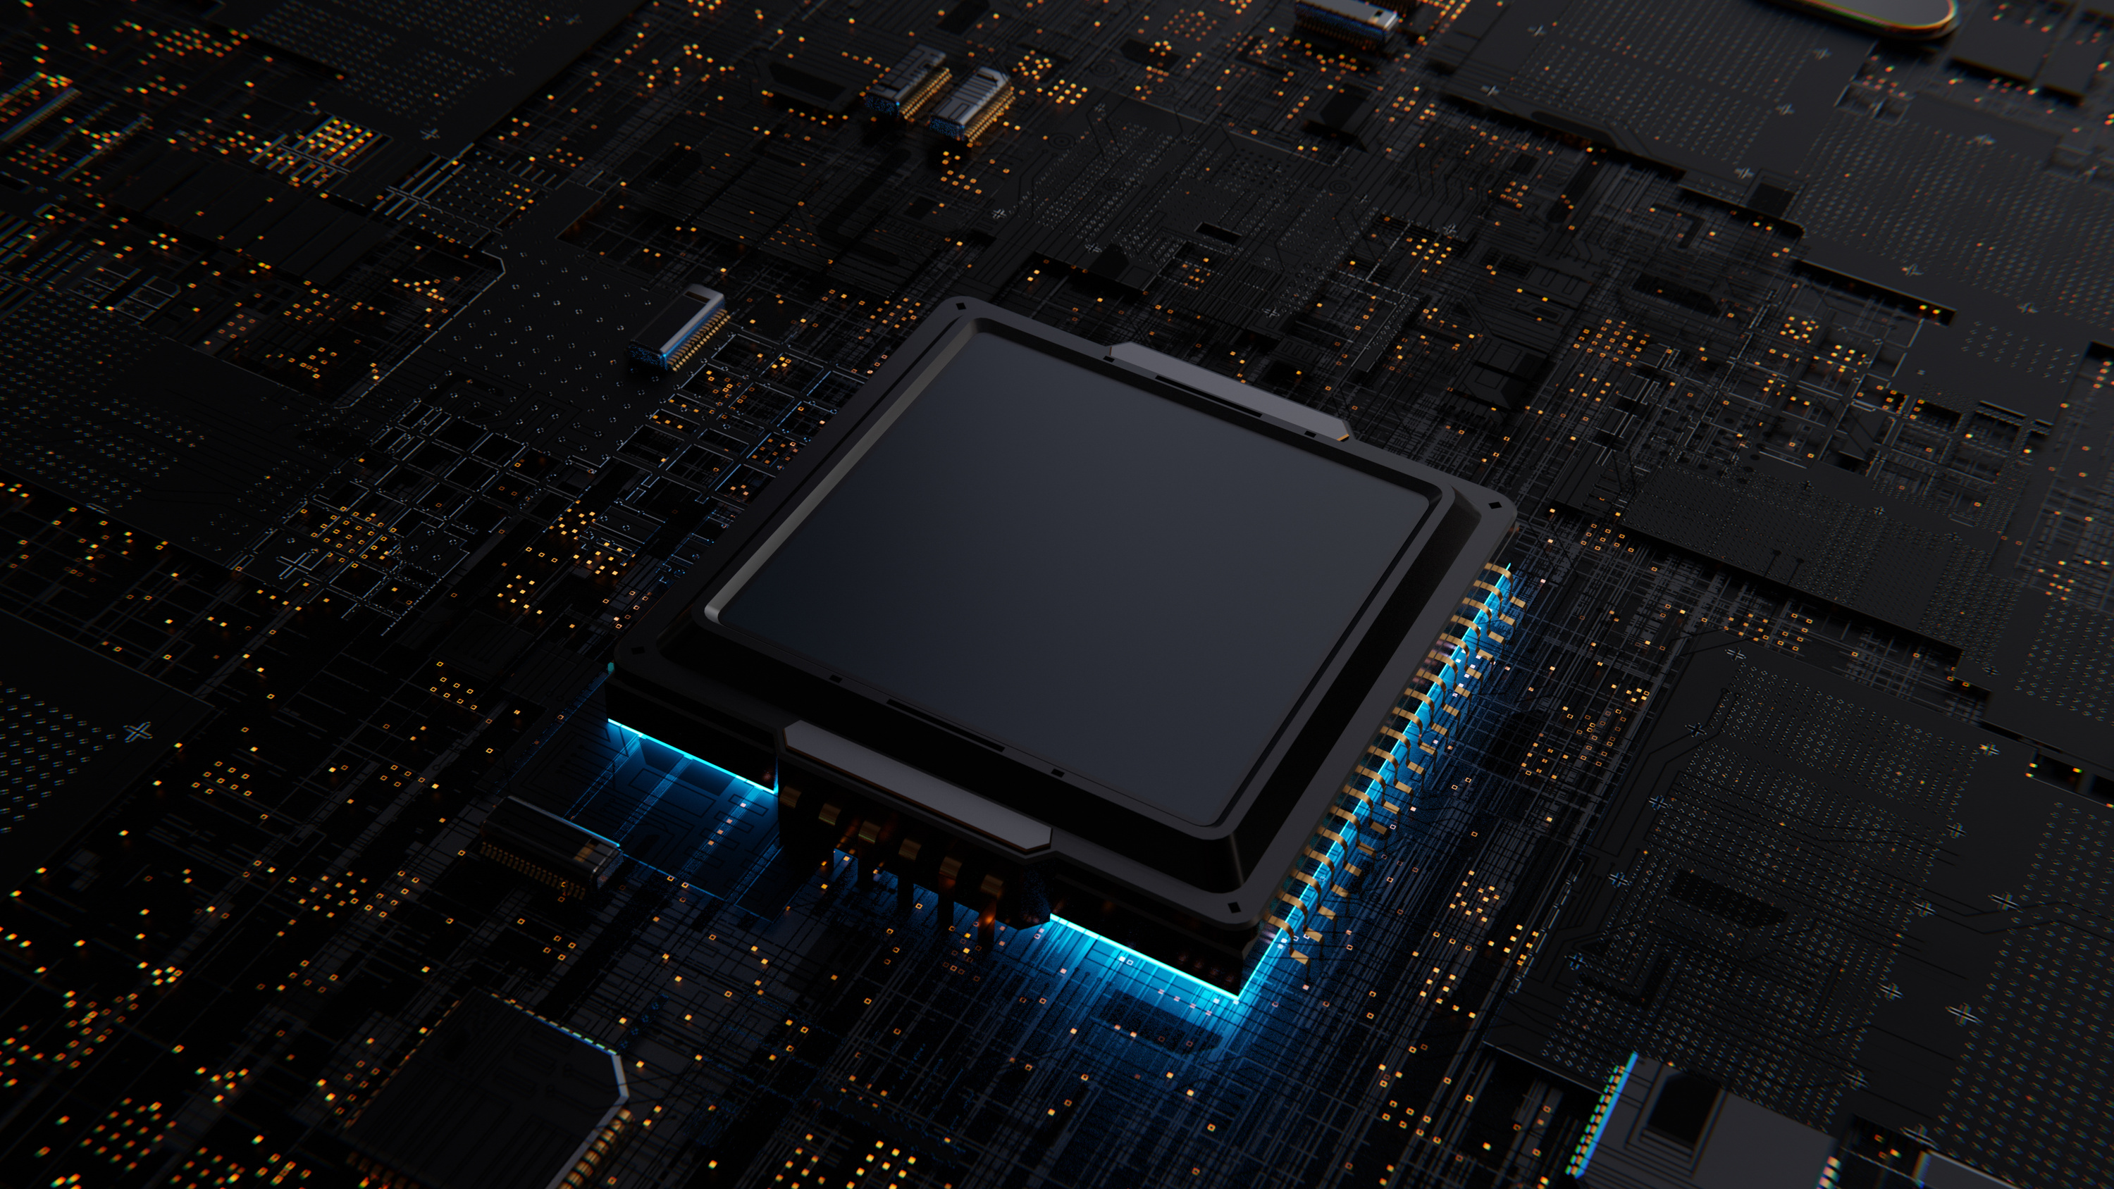
MonoWheel
robot
ROCO507Z ADVANCED ROBOT DESIGN & PROTOTYPING

Slide 2
Team
Yasas Chandrasena (10940925)
Sudeera Milakshan (10948185)
Puranjana Wijayarathna (10942674)
Tanvibahen Lakhani (10937718)
Himeth Sanjula (10749155)

Slide 3

overview
A single wheel robot which is capable of;
Self balancing
Step Climbing

Slide 4
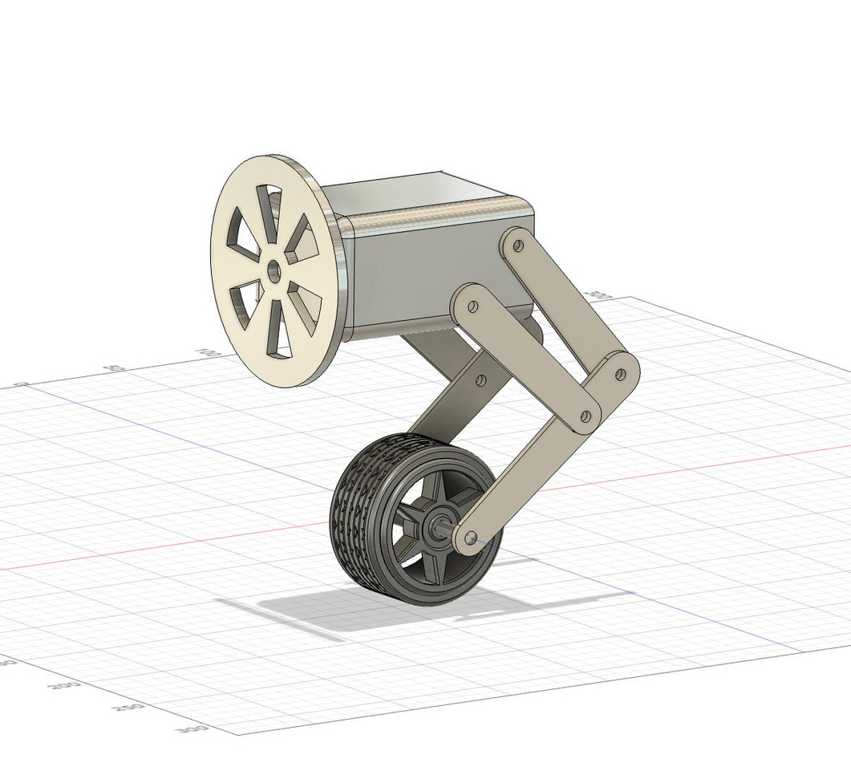
conceptual design

Slide 5
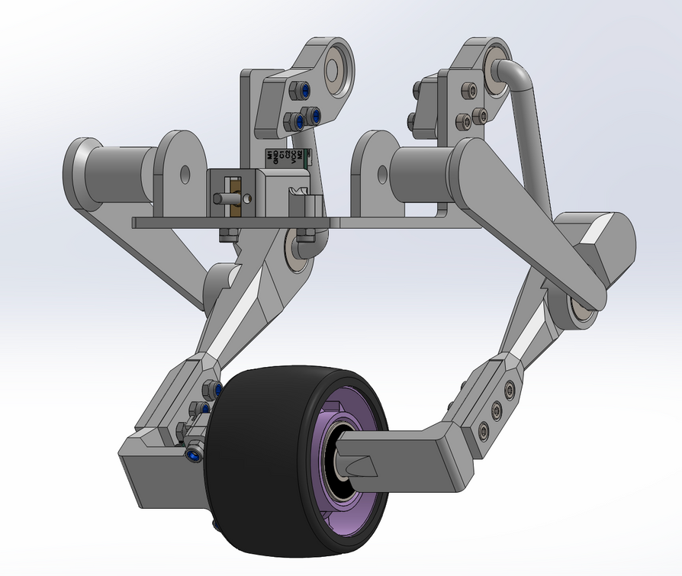
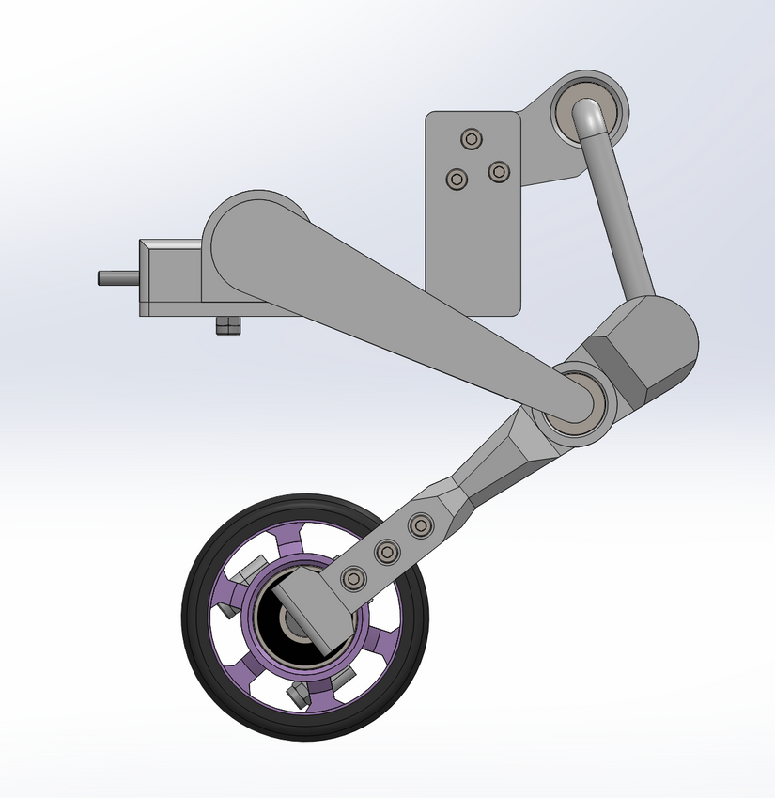
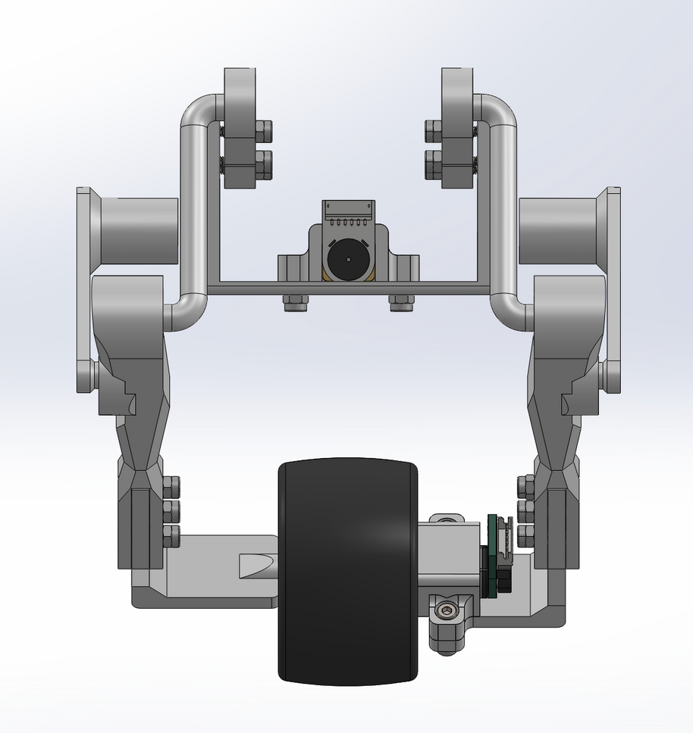
Mechanical design

Slide 6
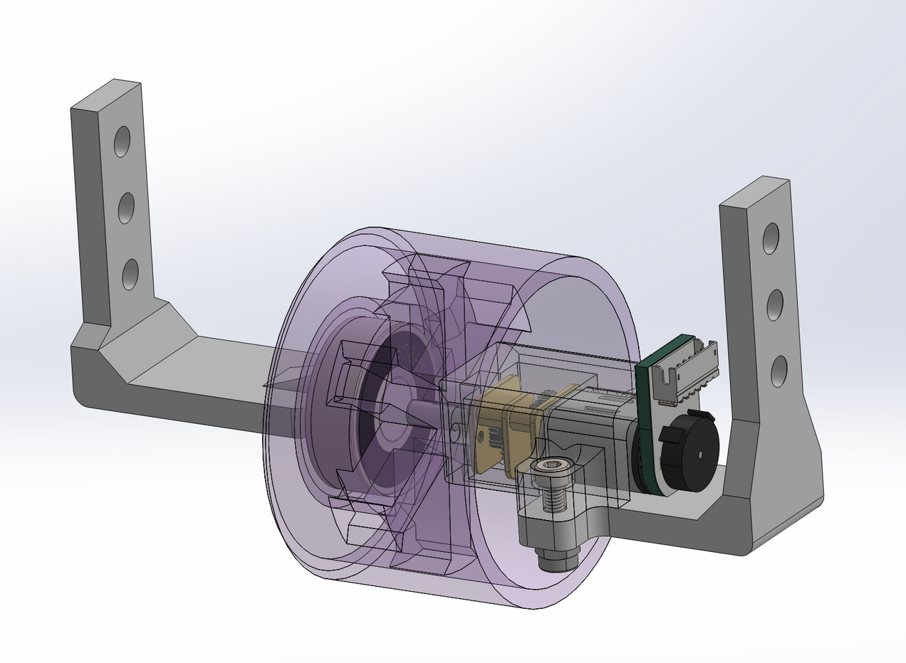
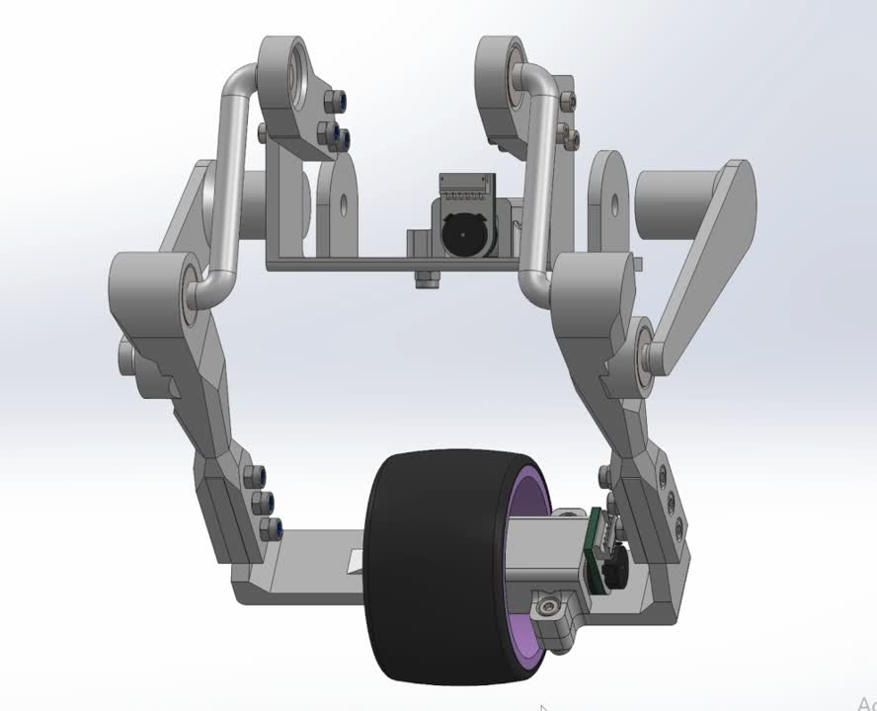
Mechanical design

Slide 7
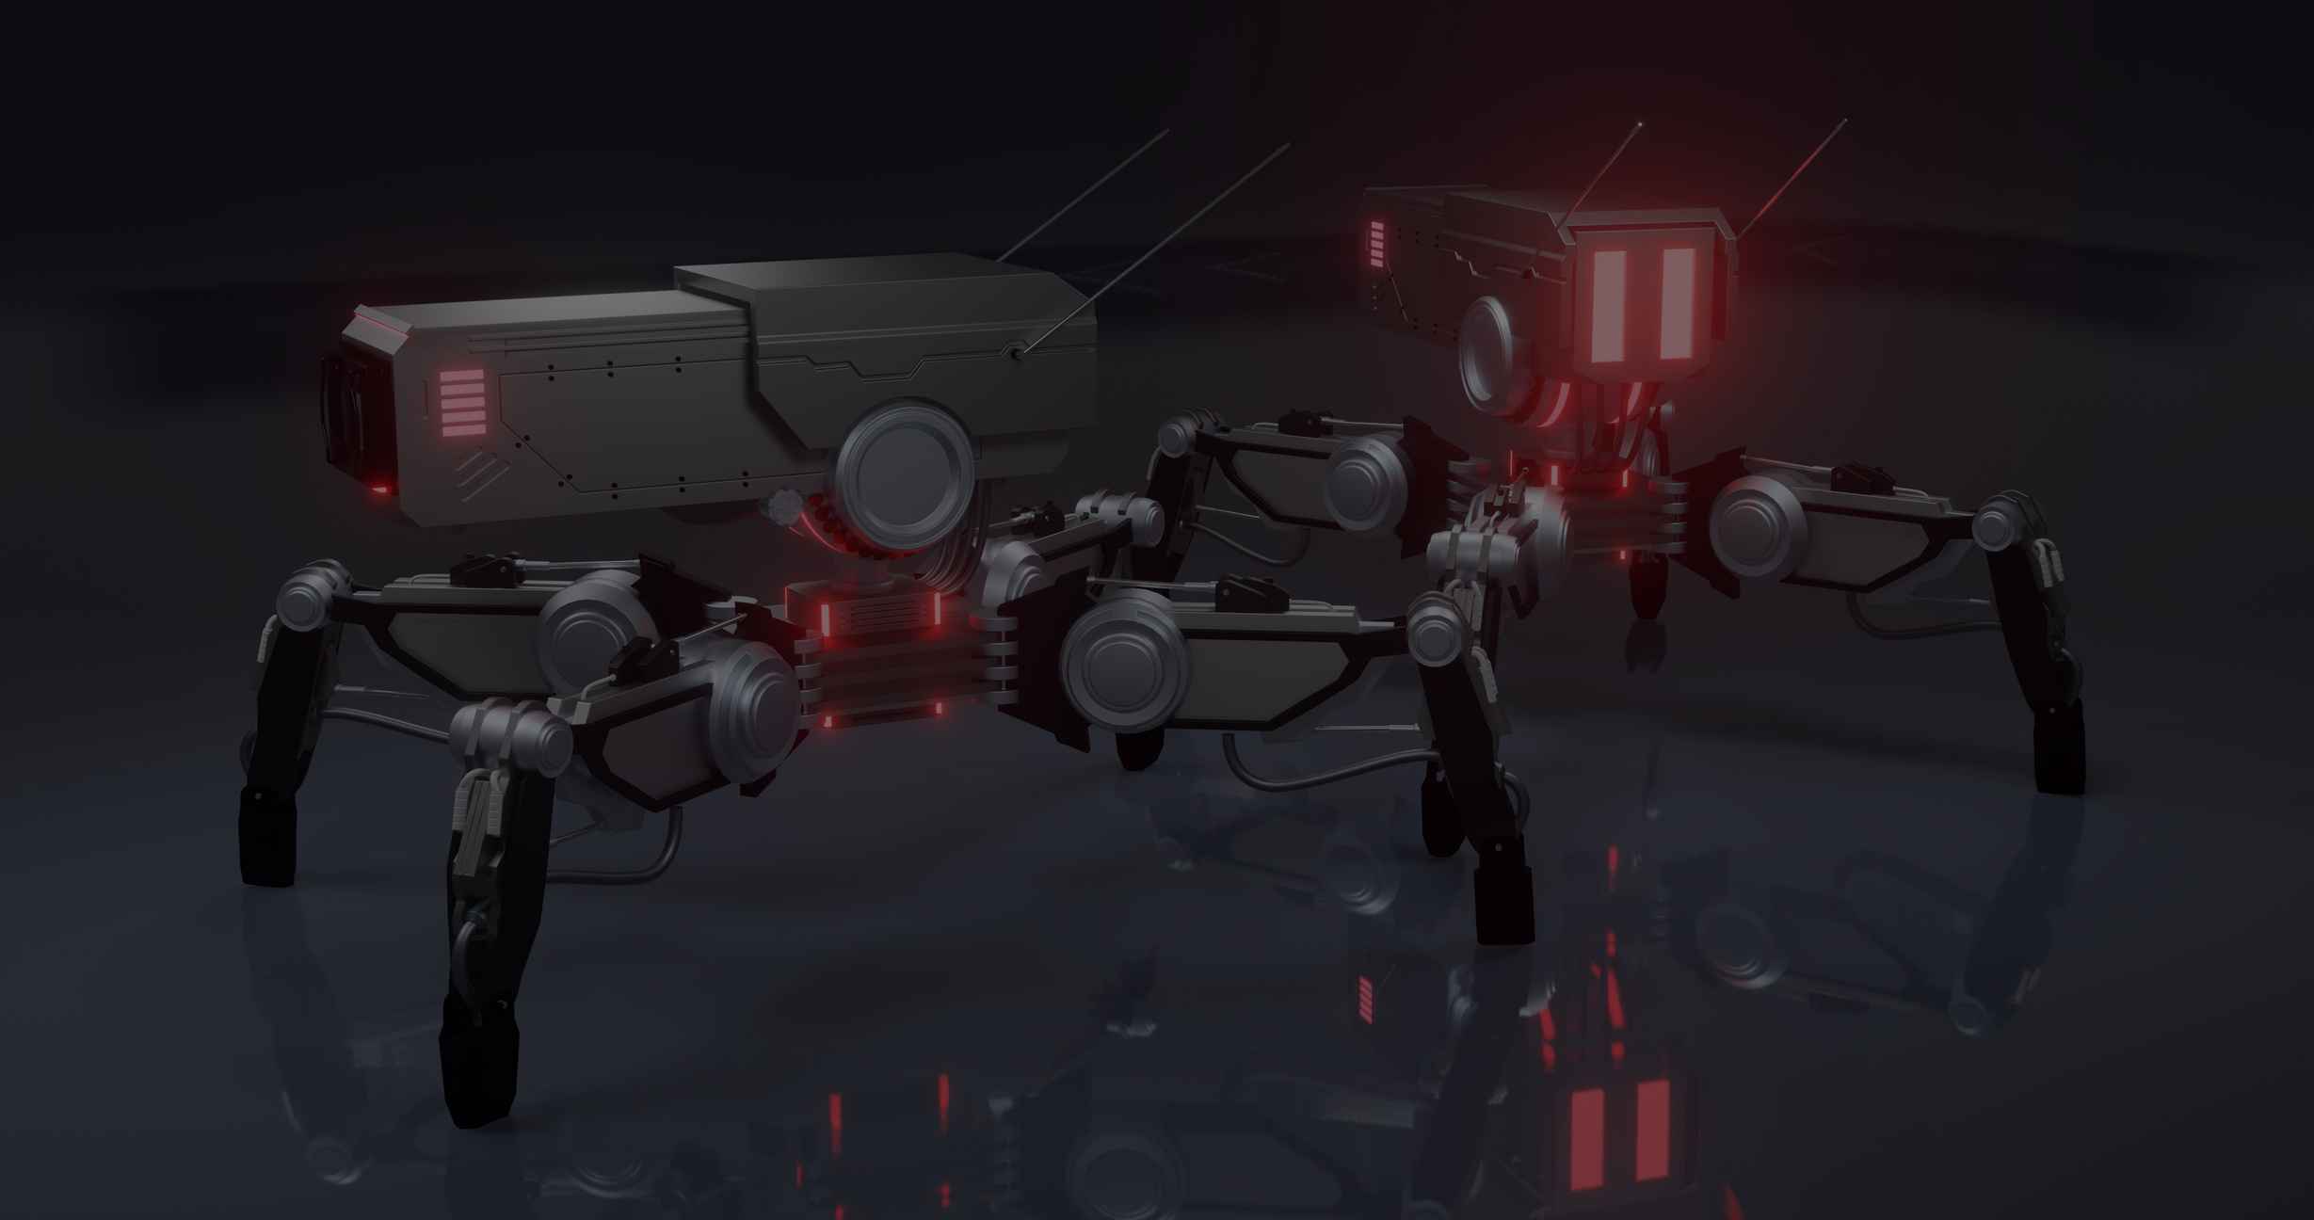
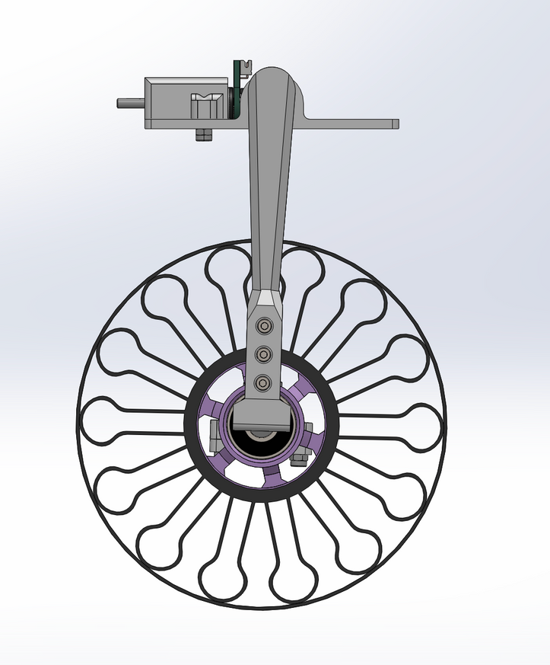
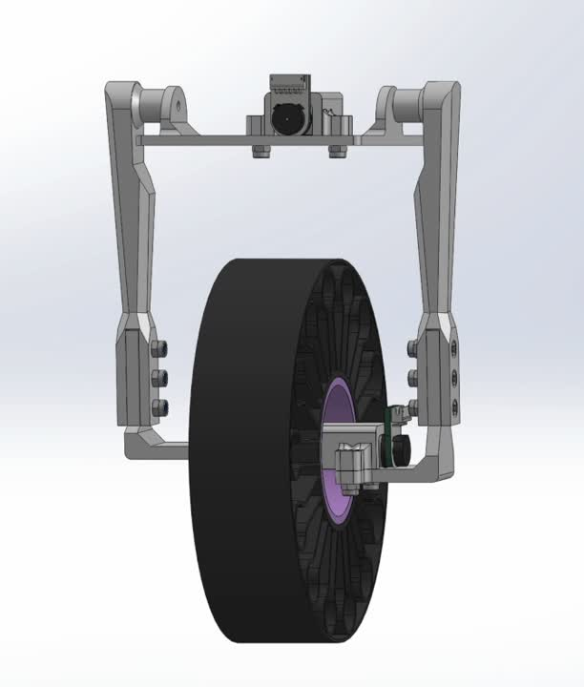
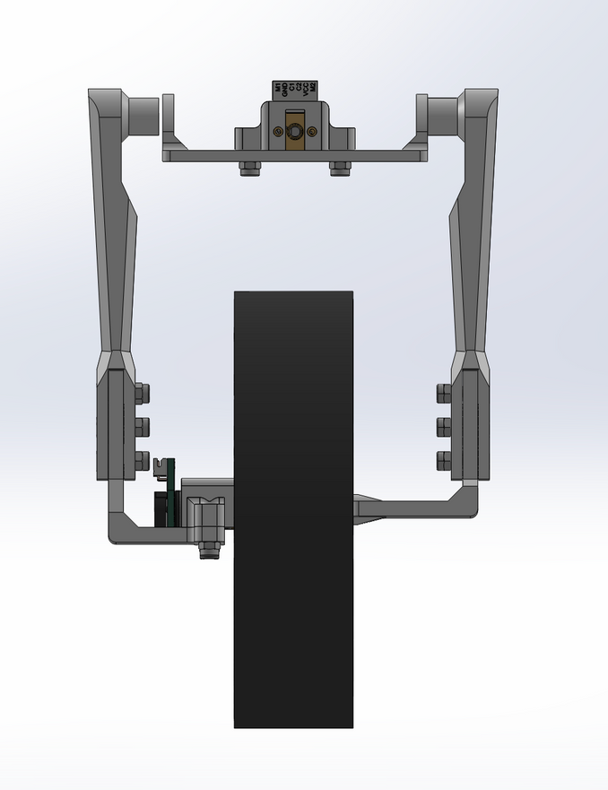
alternative design

Slide 8

Thank You
FOR YOUR ATTENTION

